Slide 1
VPN
DEC 11 – Yohannis Kifle
Joey.kifle@gmail.com

Slide 2
WHAT IS VPN?
- Virtual private network.
Virtual
private network.

Slide 3
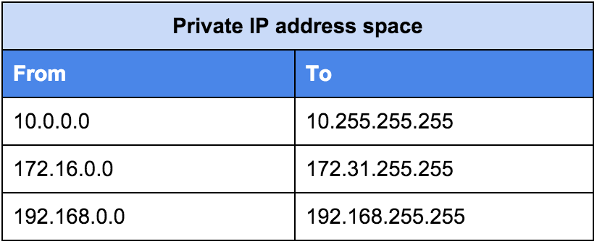
Private ip addresses

Slide 4
Cont. . .
Private IP addresses are more secured

Slide 5
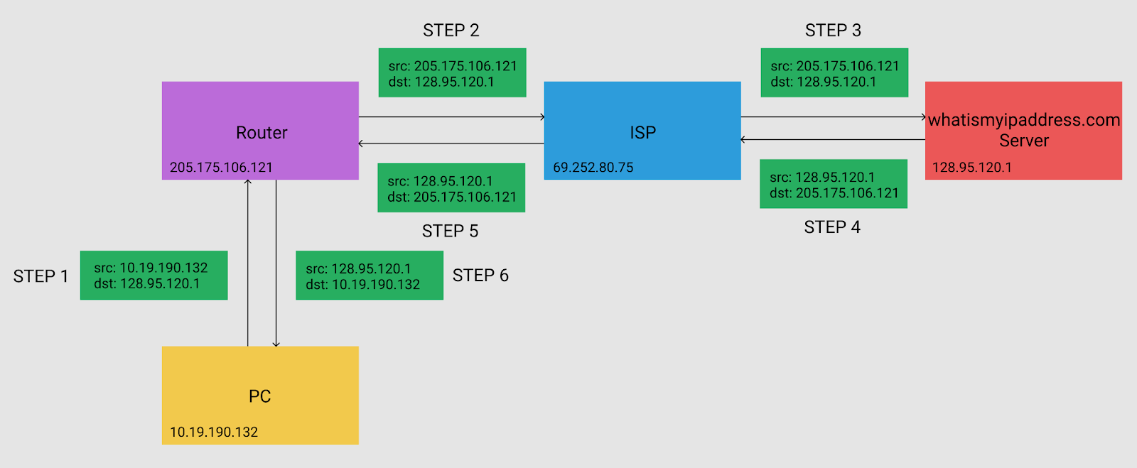
Ip packet without vpn

Slide 6
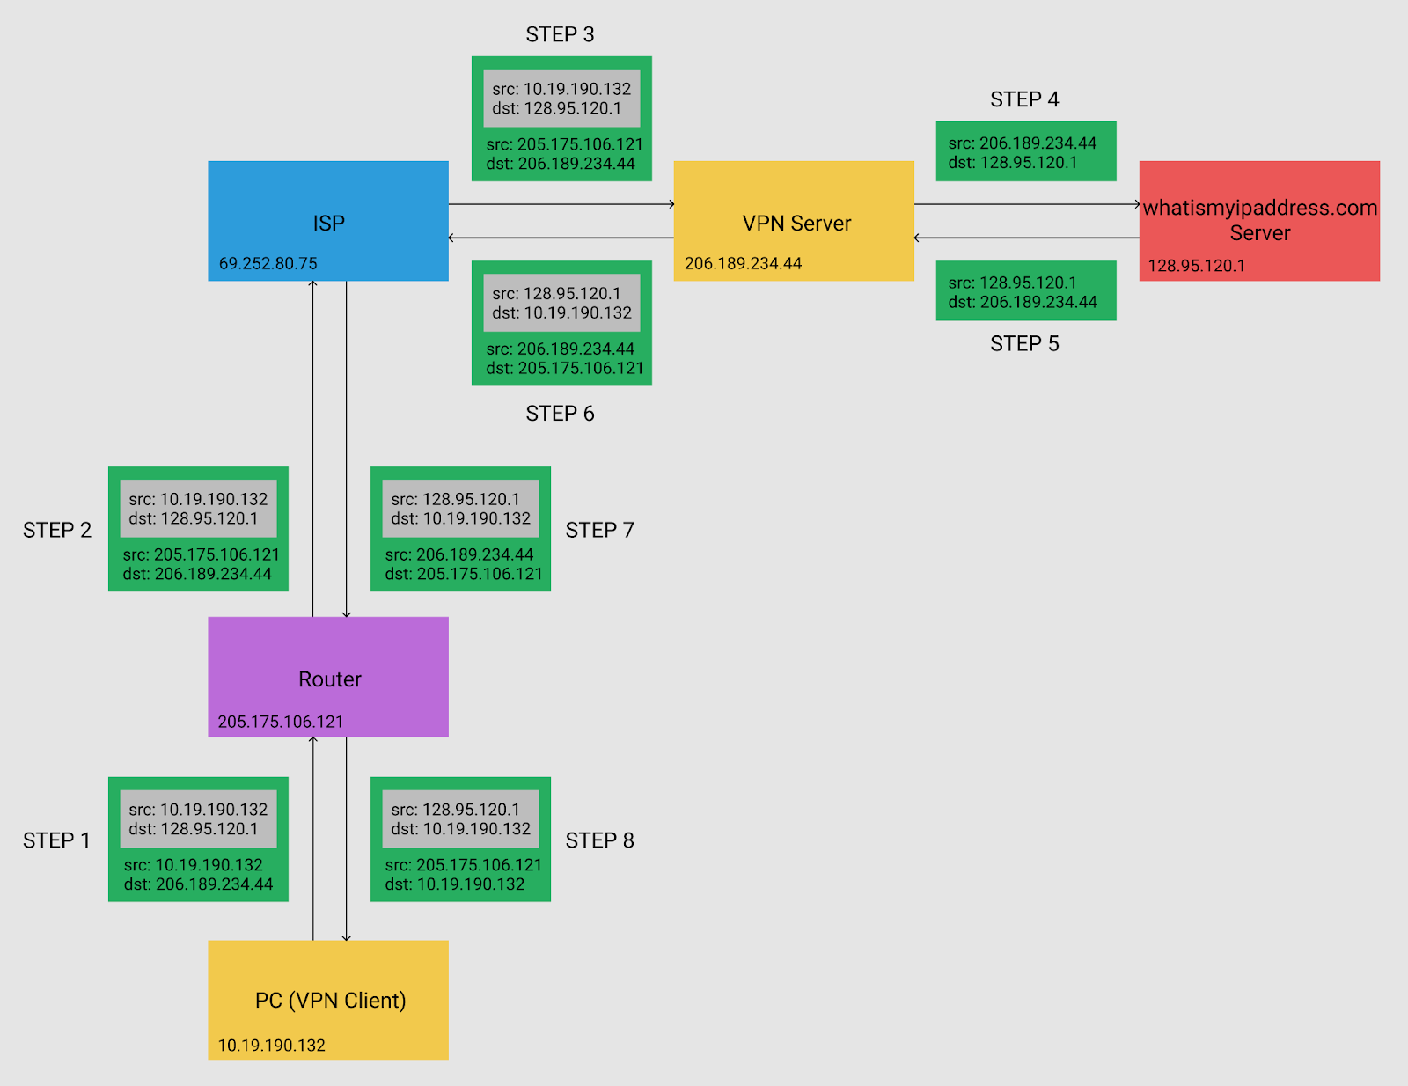
Ip packet with a vpn

Slide 7
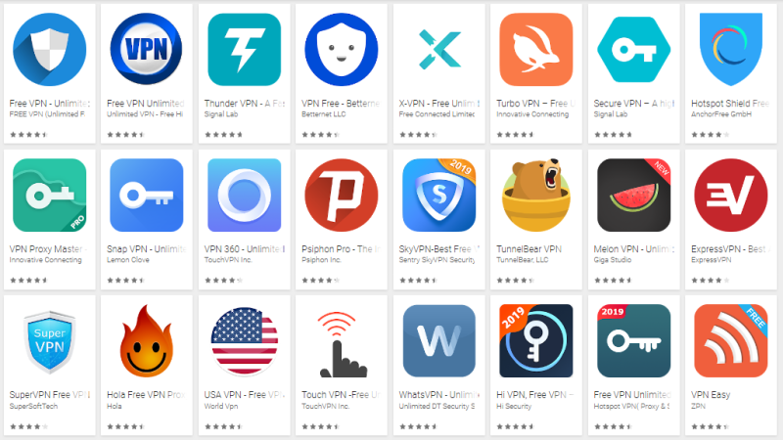
Why to build vpn app
To offer protocols that the built-int client doesn’t support
To help people connect to a VPN service without complex configuration

Slide 8
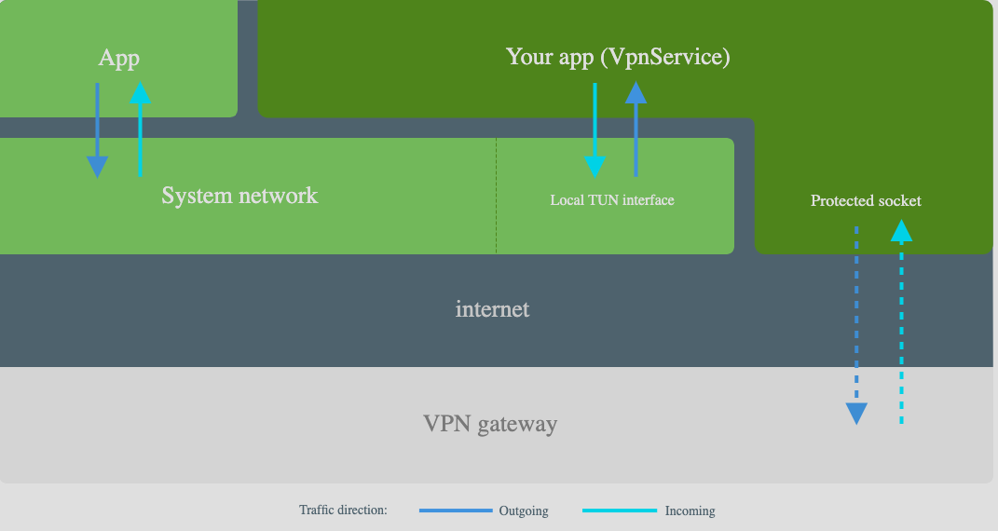
HOW VPN APPS Works

Slide 9
Cont. . .
There is only one active service per user. Starting new service automatically stops an existing service

Slide 10

Adding vpn service to your application

Slide 11
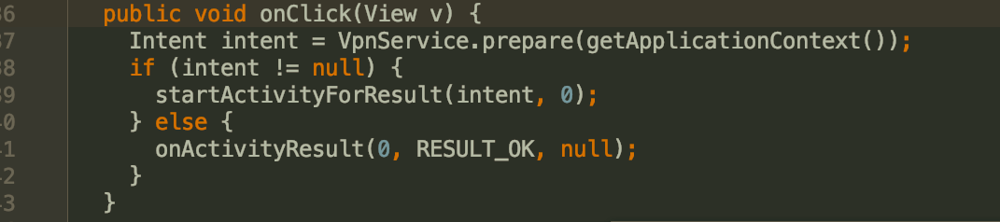
Starting vpn service

Slide 12
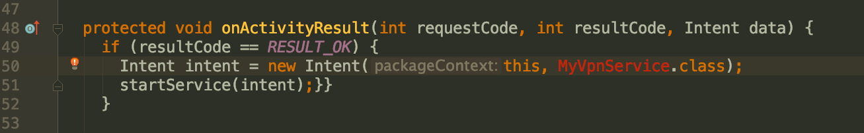
Cont.

Slide 13
IMPLEMENT VPN SERVICE
Two functions that should be implemented when extending Service class.
onStartCommand
onDestroyCommand
Usually a thread is used to provide the service in background

Slide 14
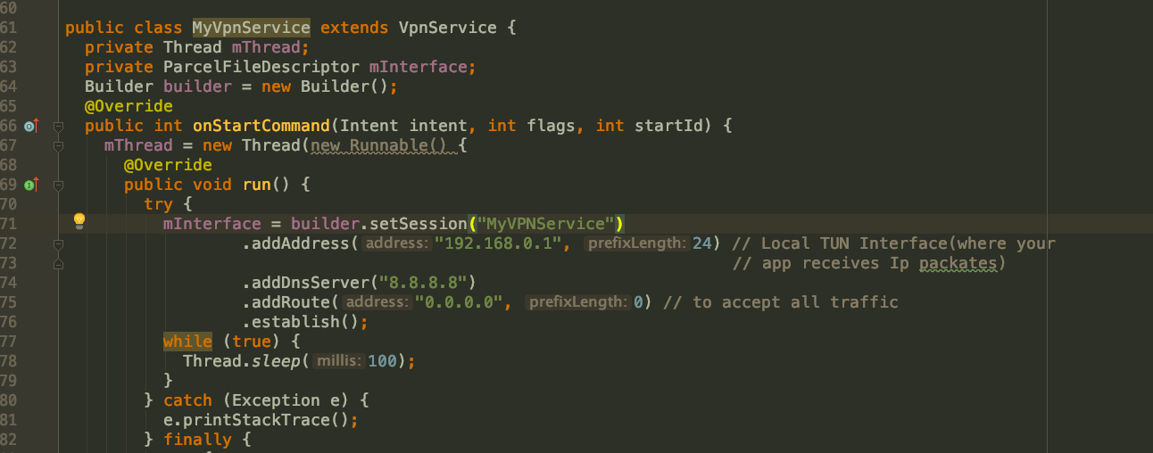
Cont. . .

Slide 15
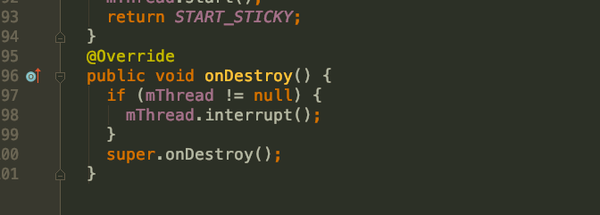

Slide 16
STEPS TO ROUTE TO VPN SERVER
Get IP packet from TUN
Extract layer 4 information (Eg. TCP/UDP, payload)
Choose corresponding socket to send out the payload
Get packet from socket, and build layer 4, then layer 3
Write IP packet back to TUN.

Slide 17
Suggestions
Building these IP Packet isn’t easy. Check with tools like Wireshark first

Slide 18
SMS servers

Slide 19
POPULAR open source SMS GATEWAY APPS
JASMIN – SMS Gateway
PlaySMS – SMS Gateway
Kannel - WAP and SMS Gateway
Kalkun – SMS Gateway and Management

Slide 20
End

